Slide 1
MIDSUMMER NIGHT’S DREAM
Worlds of the play and their languages

Slide 2
Two physical worlds, many realms of experience and language
ATHENS
Ruled by Thesus & Hyppolyta
Figures in Greek mythology
Aristocracy
Not particularly Greek, more of Shakespeare’s time
Workmen
The clowns in this play
FAIRY LAND
Ruled by Titania and Oberon
Robin & other fairies
Young aristocratic lovers enter fairy land and are spun around
Workmen enter fairy land and are “translated”

Slide 3
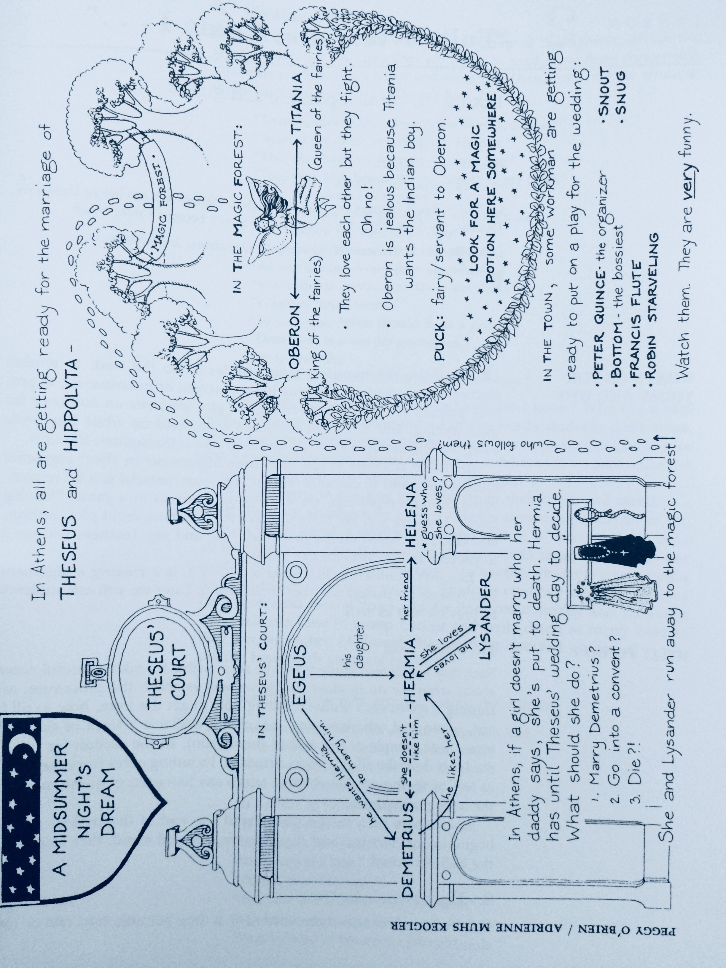

Slide 4
HOW EACH GROUP SPEAKS
Blank verse – metered but not rhymed – usually used by the highest people in society
Rhyming iambic pentameter – usually used by people in the next level down (nobles but not kings or queens)
Rhyming iambic tetrameter -- used by fairies
Rhyming iambic trimeter – used by fools
Rhyming iambic dimeter – used by Bottom who is near the bottom of society
Prose – used by the common people

Slide 5
Examples:
Prose: Bottom 1.2.68-9
Let me play the lion too. I will roar that I will do any man’s heart good to hear me.
Iambic dimeter: Bottom:
The raging rocks
And shivering shocks 1.2.28-29
Iambic trimeter: Bottom: 5.1.293 and 6
What dreadful dole is here. . .
O dainty duck, O dear
Iambic tetrameter: Robin (Puck) 2.1.8-9
And I serve the Fairy Queen
To dew her orbs upon the green
Iambic pentameter in rhymed couplets: Helena 1.1.240-1
Love looks not with the eyes but with the mind;
And therefore is winged Cupid painted blind.
Blank verse not rhymed: Hippolyta 1.1.7-8
Four days will quickly steep themselves in night;
Four nights will quickly dream away the time

Slide 6
Sentences—some unfamiliar patterns
Inversion
Subject and verb position swapped: Ageus: “Full of vexation come I” (1.1.23).
Object before the subject and verb: ie: Him I hit.
Helena: “Things base and vile, holding no quantity/Love can transpose to form and dignity” (1.1.239-39)
Interruption
Hermia to Lysander 1. 1.172-81
I swear to thee by Cupid’s strongest bow,
By . . . [this and that, swearing on and on for 8 lines]
Tomorrow truly will I meet with thee.
Omission
Just like us asking “Heard from him yet?” instead of “Have you heard from him . . .”
Thesus: ”Thrice blessed they that master so their blood” (1.1.76). Instead of “Thrice blessed are they that . . .”

Slide 7
Wordplay A main reason Elizabethans went to the theater
Puns (playing with multiple meanings of words)
“Wood” meant crazy, so when the lovers flee to the wood . . .
On “hail”: Helena: For ere Demetrius looked on Hermia’s eyene,
He haled down oaths that he was only mine:
And when his hail some heat from Hermia felt,
So he dissolved, and show’res of oaths did melt. (1.1.248-51)
Malapropisms (Bottom does this a lot and we love him for it)
“But I will aggravate my voice so that I will roar you as gently as any sucking dove” (1.2.78-80). He confuses “aggravate” with “moderate” and mixes up “suckling lamb” with “sitting dove.”

Slide 8
More Wordplay
Figurative language esp. “epic similes” in Midsummer
The course of true love never did run smooth . . .
[since] if there were a sympathy in choice,
War, death, or sickness did lay siege to it,
Making it momentany as a sound,
Swift as a shadow, short as any dream,
Brief as the lightning in the collied night,
That, in a spleen, unfolds both heaven and Earth,
The jaws of darkness do devour it up.
So quick bright things come to confusion.
Anatomical Humor (how low can you go?)
“Arise”: to have an erection (when Titania tells Bottom “Arise, arise” she isn’t talking about getting out of bed.)
“Bottom”: character name, buttocks or ass, which is a pun on the beast Bottom turns into.
“Cod”: A common pun referring to the male organ. But anything about fish was automatically suggestive. “Codpiece” = jockstrap worn on the outside.
“Count”: Often used for its similarity to the slang word for female genitalia.
“Die”: Sexual intercourse or orgasm. Elizabethans thought each one shortened your life by a minute.

Slide 9
The rauchy stuff goes on and on. . .
“Green” connotes virility and potency
“Horns” and the “cuckoo” bird: refer to being a “cuckold,” one whose wife is sleeping with someone else (another bird lays its eggs in your nest, like the cuckoo).
“Hell”: slang often used on passages of sexual nausea to indicate a woman’s genitals. See Sonnet 144 in which the poet suspects the friend of being inside the Dark Lady’s hell.
“Leaping House” : Brothel
“Naught”: wickedness, with implications of sexual intercourse, especially adultery
Honestly, that’s just the beginning. This is not to memorize, but to appreciate just how bawdy the bard can be.

